Slide 1
Animal Behavior
Dhanush Banka

Slide 2
What is Behavior?
Response to a stimulus carried out by the muscular or endocrine systems
It helps with:
Gathering food
Reproduction
Homeostasis

Slide 3
Explanations for Behavior
Proximate causation
“How”
Environmental Stimuli
Mechanisms underlying a behavior
Ultimate causation
“Why”
Evolutionary significance

Slide 4
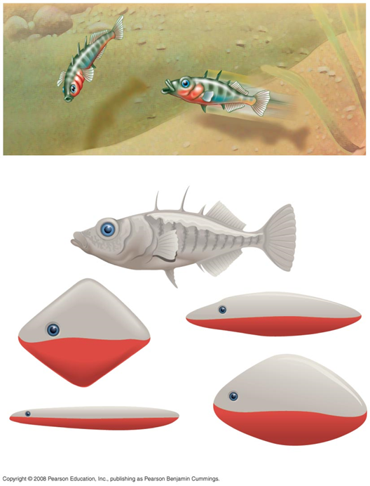
Fixed Action Patterns
Sequence of unlearned innate behaviors
Carried to completion once initiated
Triggered by a sign stimulus
Greater stimuli lead to larger responses

Slide 5
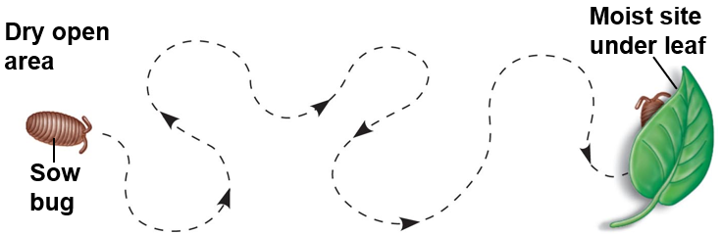
Taxis and Kinesis
Taxis
Oriented/Directional movement
Caused by environmental cues
Ex: Fish swimming upstream
Kinesis
Non-directional change
Change in activity or rate
Bugs are more active in dry areas and less active in humid areas

Slide 6
Migration
Regular, long-distance change in animal location
Orientation
Sun and Circadian clock
North Star
Earth’s magnetic field

Slide 7
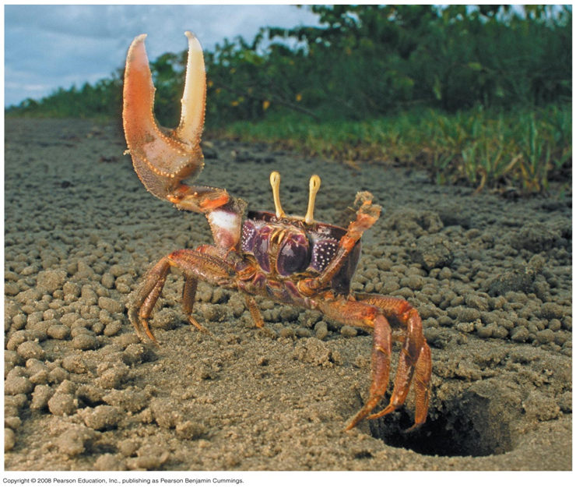
Behavioral Rhythms
Circadian Rhythms
Behaviors linked to seasonal change
Migration
Reproduction
Lunar cycles

Slide 8
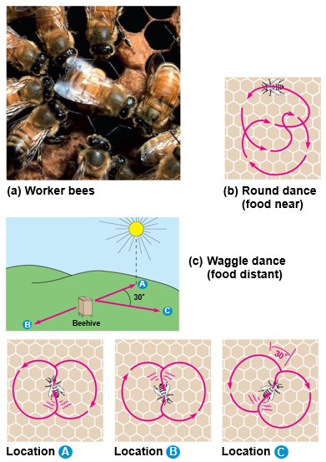
Signals and Communication
A signal is a behavior that causes a change in another animal’s behavior
Communication is the transmission and reception of signals
Many animals are capable of complex communication to share information

Slide 9
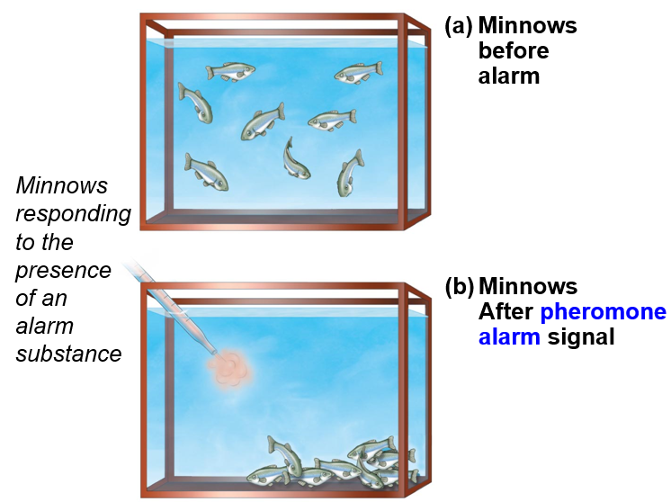
Pheromones
Pheromones are chemical substances used for communication
Effective at low concentrations
A common example is alarm substances in fish skin

Slide 10
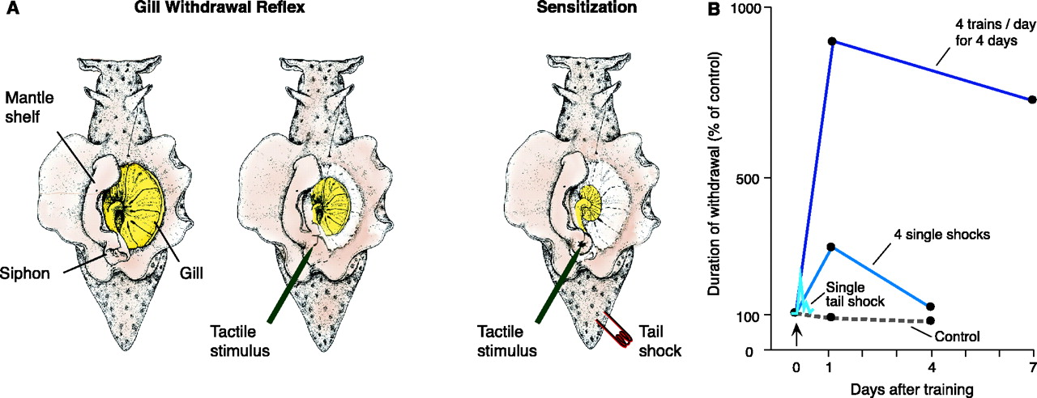
Habituation
Loss of responsiveness to stimuli
Occurs if stimuli convey no important information

Slide 11
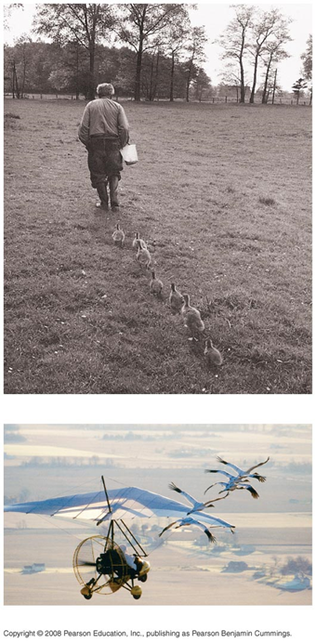
Imprinting
Distinguished by sensitive critical learning period
Limited to developmental phase
Generally irreversible

Slide 12
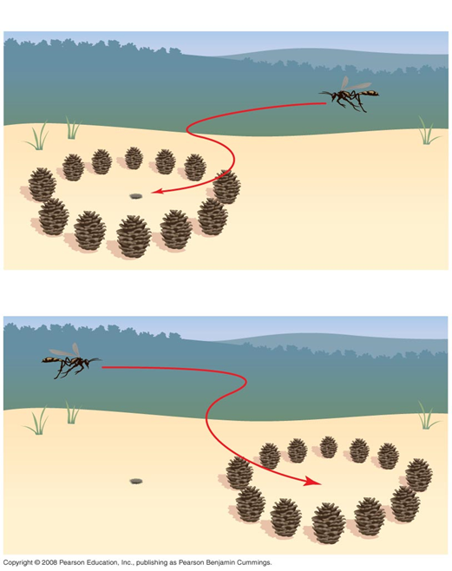
Spatial Learning
Based on spatial structure of environment
Uses landmarks
Cognitive map is an internal representation of spatial relationships

Slide 13
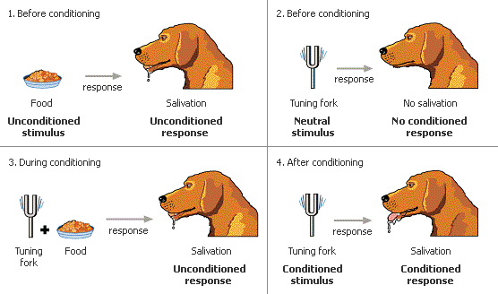
Associative Learning
One feature of the environment is associated with another
Classical conditioning
An arbitrary stimulus is associated with a reward or punishment
Operant conditioning
A behavior is associated with a reward or punishment
Trial-and-error

Slide 14
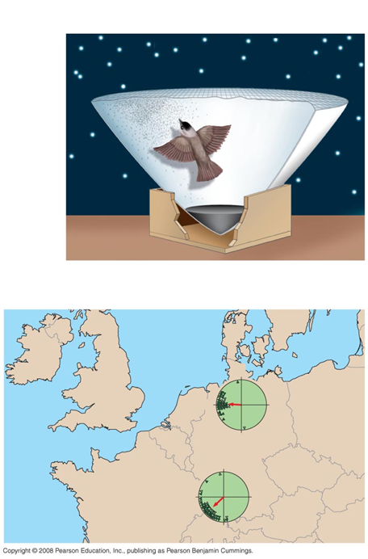
Regulatory Genes
Behavior is controlled by genetic and environmental factors
Cross-fostering studies are used to identify this interaction
Regulatory genes
Master regulatory gene controls many behaviors
Multiple independent genes can contribute to a single behavior

Slide 15
Natural Selection
Genetic components of behavior evolve through natural selection
Fitness is affected by behavior such as foraging and mate choice
Natural selection enhances efficiency of feeding
Optimal foraging model
Balancing risk and reward

Slide 16
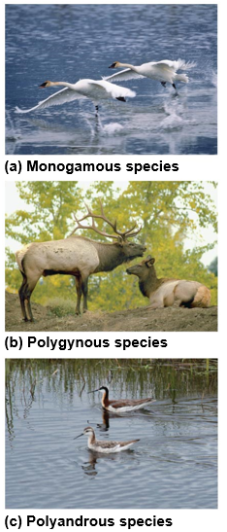
Mating Behavior
Mating behavior is a result of sexual selection
Relationship between males and females varies in each species
Monogamous
Polygamous
Relationship depends on the needs of the young and paternal certainty

Slide 17
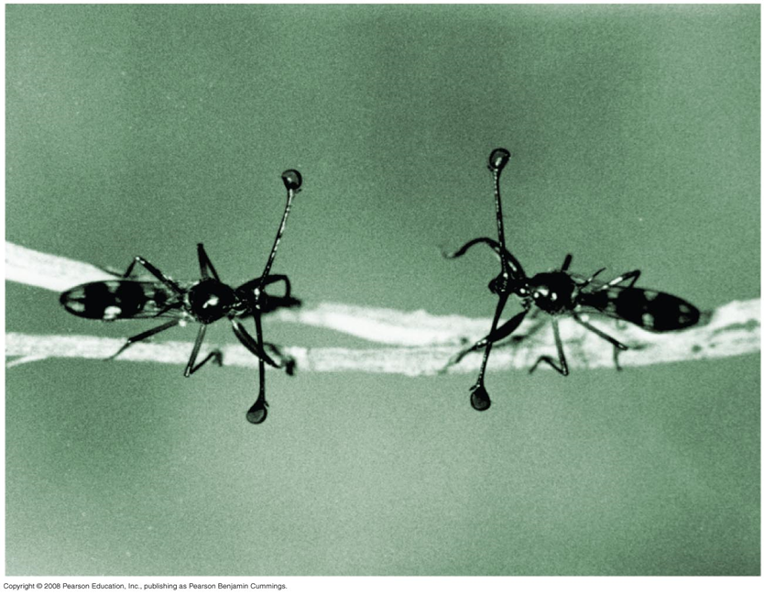
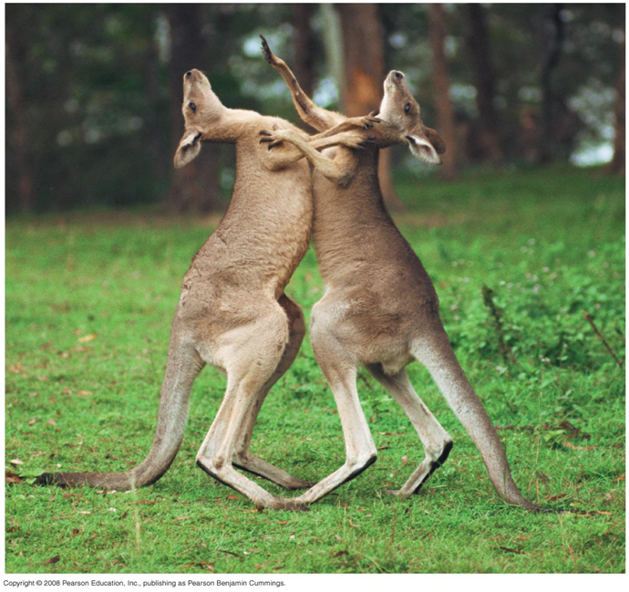
Mate Choice
Female choice (intersexual competition)
Choosing males with specific behaviors or anatomy
Male competition (intrasexual competition)
Involves agonistic behavior

Slide 18
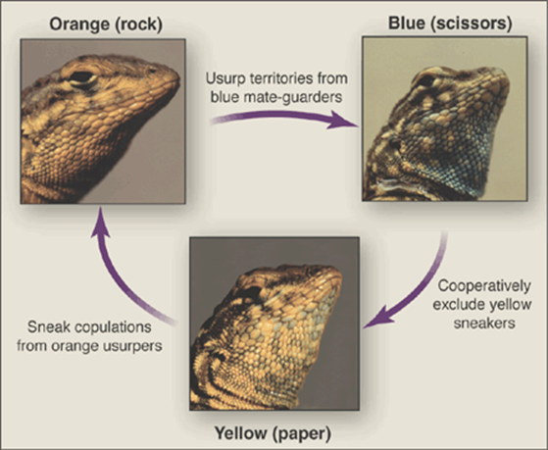
Game Theory

Slide 19
Altruism
Behavior that reduces individual fitness but increases the fitness of others
Inclusive fitness
Proliferation of individual genes by producing offspring
Helping close relatives produce offspring
Altruistic behavior toward unrelated individuals for returned aid is reciprocal altruism

Slide 20
Hamilton’s Rule
3 key variables in an altruistic act
Benefit to the recipient (B)
Cost to the altruist (C)
Coefficient of relatedness (r)
Natural selection favors an altruistic act when rB > C
Kin selection is natural selection favoring altruistic behavior

Slide 21
Example Problem
A mother antelope and its child are galloping along the plains, when they encounter a group of hungry lions. If the two antelopes try to escape the lions together, there is a 75% chance that both will be consumed and eaten, and a 25% chance that both will escape alive. If, however, the mother sacrifices herself to the lions, she may be able to buy her baby additional time to escape.
What is the minimum chance that the baby can have to escape from the lions following such a sacrifice such that the mother’s action will be evolutionarily favored? You may assume that the baby antelope, once escaped, will be guaranteed to survive into a reproducing adult, and that the mother antelope is at the beginning of reproductive age.

Slide 22
Solution
r = 0.5
B = p - 0.25, with p as the probability of survival given the sacrifice happens
C = 0.25 (25% chance of survival being given up)
0.5 (p - 0.25) > 0.25 → p > 0.75

